Slide 1
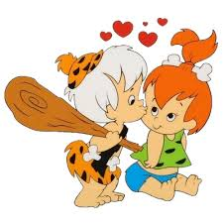
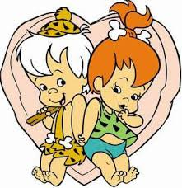
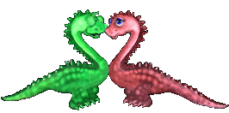
February 7, 1993
Pebbles and Bam Bam Wed!!

Slide 2
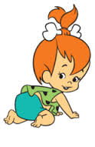
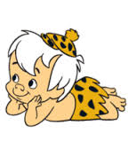
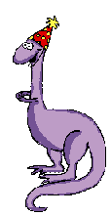
The Flinstones!
The Flinstones is a television show that was originally the first animated series!
Its premiered from 1960-1966
This show was first aired on September 30th, but on February 7th, 1993 the younger children of the Flinstones grew up!
Pebbles and Bam Bam got married!

Slide 3
FlinSTONE/Rebble Family Tree
Fred Flinstone
Wilma Flinstone
Barney Rebble
Betty Rebble
Pebbles Flinstone
Bam Bam Rebble
Roxy Rebble
Chip Rebble

Slide 4
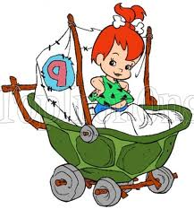
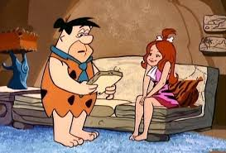
Pebbles
Pebbles is the Orange/red haired baby girl on the show! She was always sweet and kind and always hung out with Bam Bam!
Pebbles grew up to be a great adult! Soon enough the boy she grew up with became her husband!

Slide 5
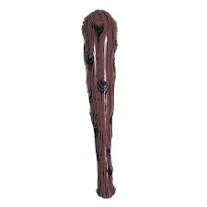
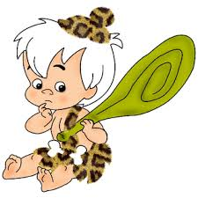
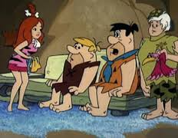
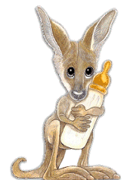
BamBam
Bam Bam was the white haired boy from the Flinstones!
Bam Bam always had a bat and always hit things with it! He was the son of Barney and Betty Rubbles.
He grew up with Pebbles!

Slide 6
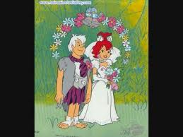
Married!
Pebbles and Bam Bam got married and sorta left the show a little.
Pebbles and Bam Bam’s parents didn’t like them getting married, but they got married anyways!
They lived happily through the seasons and episodes of the Flinstones!

Slide 7
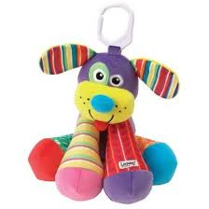
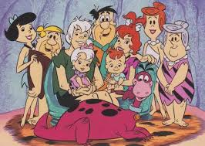
Children!
Bam bam and pebbles had 2 kids!
The girl child was named Roxy! She had white hair like her father, Bam Bam!
The boy was named Chip! He had orange/red hair like his mother, Pebbles.

Slide 8
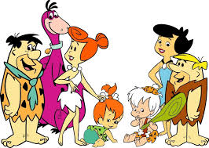
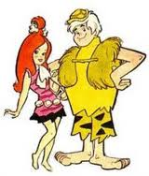
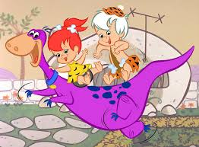
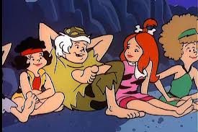
THE END

